Slide 1





AtliQ Hardware
CONSUMER
GOODS
AD-HOC INSIGHTS
Presented by:- TARUN YADAV

Slide 2
AtliQ Hardware
OBJECTIVES
1. Atliq Hardware (imaginary company) a prominent computer hardware manufacturer in India with a substantial global presence, recognizes the imperative of data-driven decision-making for sustained growth and competitive advantage.
2. Despite its expansive operations, the management has identified a critical gap in obtaining timely and insightful data, prompting the need for a robust data analytics team to enhance organizational agility.
3. In response to this need, Tony Sharma, the Director of Data Analytics at Atliq Hardware, has initiated a strategic hiring process to onboard several junior data analysts capable of bridging the gap between technical proficiency and strong interpersonal skills.
4. To evaluate potential candidates effectively, a comprehensive SQL challenge has been devised. This challenge aims to assess not only technical prowess but also the ability to synthesize data insights and communicate them coherently.
5. By implementing this rigorous hiring process, Atliq Hardwares aims to fortify its data analytics capabilities, ensuring a proficient and versatile team that can contribute to informed decision-making in an increasingly competitive industry landscape.

Slide 3
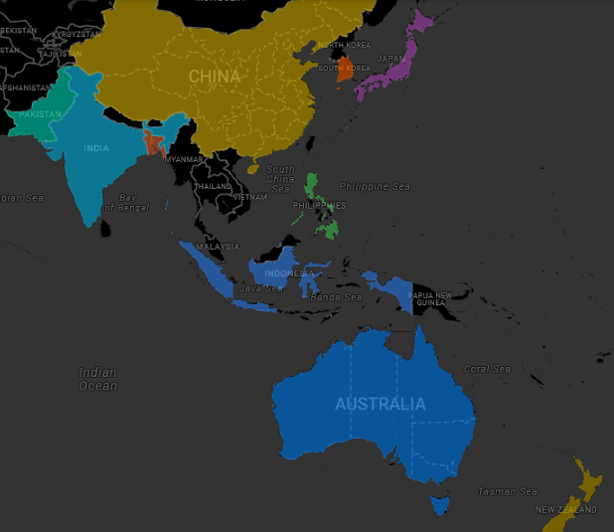
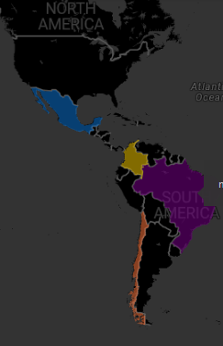
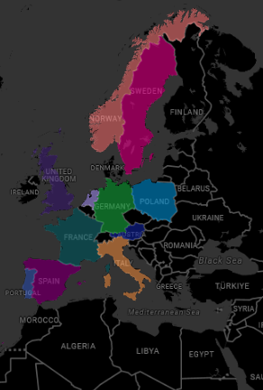
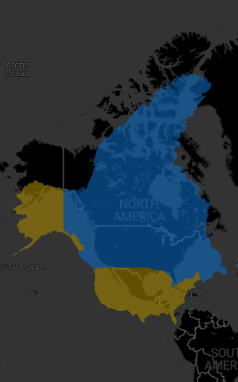
AtliQ Hardware
ATLIQ HARDWARE MARKET
EU
APAC
LATAM
NA

Slide 4
GAMING LAPTOP
BUSINESS LAPTOP
PERSONAL LAPTOP
AtliQ Hardware
ATLIQ HARDWARE PRODUCT LINE
NOTEBOOKS
BUSINESS DESKTOP
PC
DESKTOPS
PERSONAL DESKTOP
P&A
PRODUCTS
WIFI EXTENDER
NETWORKING
PERIPHERIALS
ACCESSORIES
USB FLASH DRIVE
N&S
Add even more sub-ideas
Add even more sub-ideas
PROCESSORS
EXTERNAL SSD
Add even more sub-ideas
STORAGE
GRAPHIC CARD
MOTHERBOARD
INTERNAL HDD

Slide 5
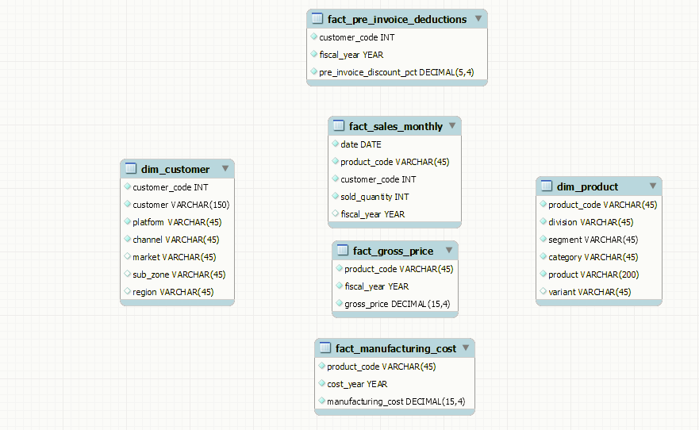
AtliQ Hardware
INPUT DATA

Slide 6

AtliQ Hardware
AD-HOC REQUESTS
ALONG WITH THE
QUERIED RESULTS
VISUALIZATIONS
INSIGHTS

Slide 7
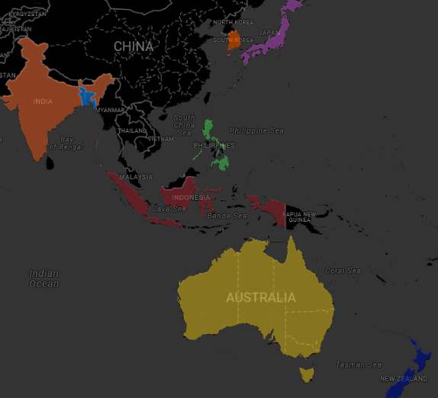

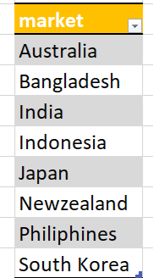
AtliQ Harfware
REQUEST 1
Provide the list of markets in which customer "Atliq Exclusive" operates its
business in the APAC region.
OUTPUT
INSIGHT
Atliq Exclusive has established a presence in eight key markets within the APAC

Slide 8
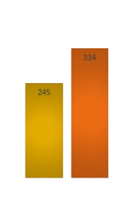
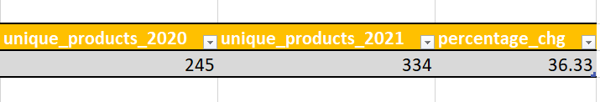
AtliQ Harfware
What is the percentage of unique product increase in 2021 vs. 2020? The final output contains these fields,
unique_products_2020
unique_products_2021
percentage_chg
REQUEST 2
OUTPUT
INSIGHT
In FY 2020, we had a total of 245 products, and in FY 2021, the number increased to 334, reflecting a 36% growth.

Slide 9
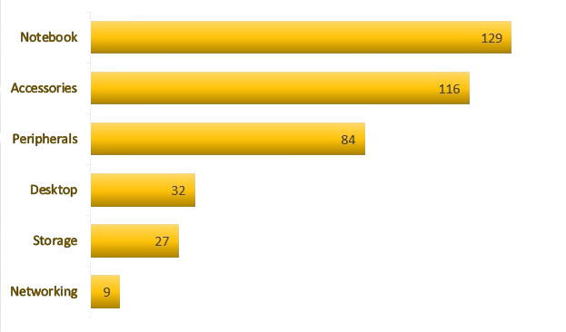
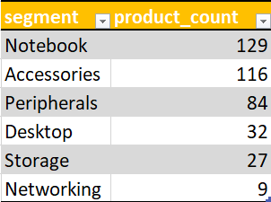
AtliQ Harfware
Provide a report with all the unique product counts for each segment and sort them in descending order of product counts. The final output contains 2 fields,
segment
product_count
REQUEST 3
OUTPUT
INSIGHT
• Atliq Hardware presents an extensive array of products across the Notebook, Peripherals, and Accessories sectors.
• There is a strategic need to broaden the product portfolio within the desktop, networking, and storage markets.
• To address this, Atliq Hardware has the opportunity to introduce Trending Products in these specific markets.

Slide 10
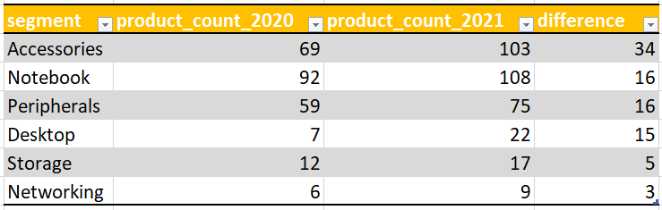
AtliQ Harfware
Follow-up: Which segment had the most increase in unique products in 2021 vs 2020? The final output contains these fields,
segment product_count_2020
product_count_2021
differencet
REQUEST 4
OUTPUT
INSIGHT
In 2021, Atliq Hardware primarily focused on expanding its presence in the accessories market, introducing a total of 34 new accessory products to the market.

Slide 11


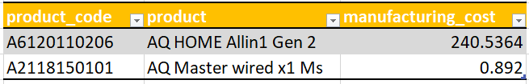
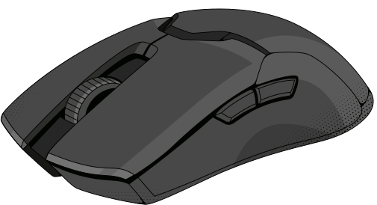
AtliQ Harfware
Get the products that have the highest and lowest manufacturing costs. The final output should contain these fields,
product_code,
product,
manufacturing_cost
REQUEST 5
204 $
OUTPUT
AQ HOME Allin1 Gen 2
Personal Destop
0.8 $
AQ MASTERWIRED x1 Ms
Mouse

Slide 12
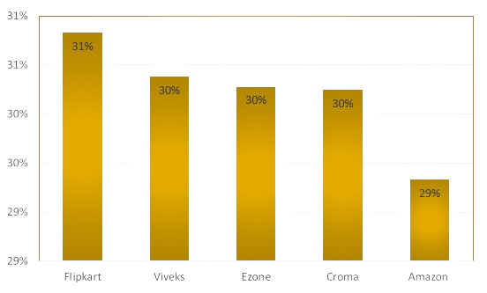
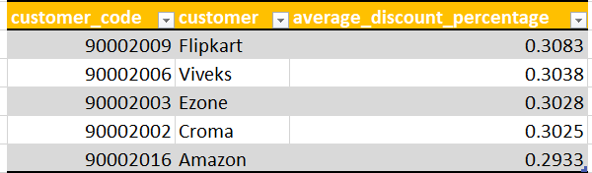
AtliQ Harfware
Generate a report which contains the top 5 customers who received an average high pre_invoice_discount_pct for the fiscal year 2021 and in the Indian market. The final output contains these fields,
customer_code
customer
average_discount_percentage
REQUEST 6
OUTPUT
INSIGHT
Considering Flipkart holds the position of the most heavily discounted customer in the Indian market, with a pre-invoice discount percentage of Atliq extended approximately similar pre-invoice discount percentages to each of its top 5 clients in 2021.

Slide 13
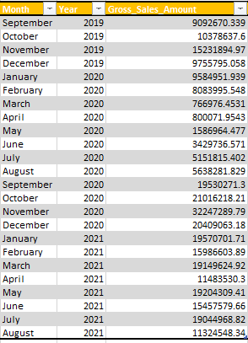

AtliQ Harfware
Get the complete report of the Gross sales amount for the customer “Atliq Exclusive” for each month. This analysis helps to get an idea of low and high-performing months and make strategic decisions. The final report contains these columns: Month
Year
Gross sales Amount
REQUEST 7
OUTPUT

Slide 14
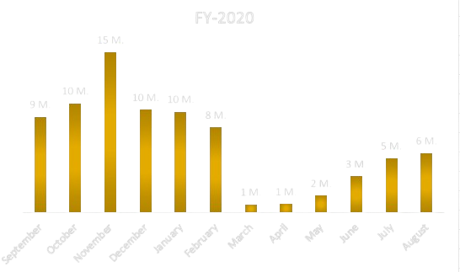
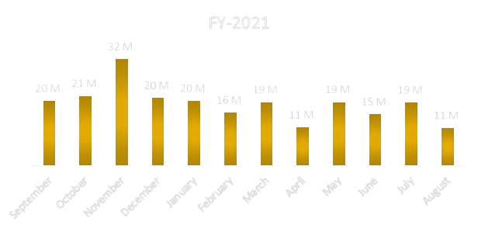
AtliQ Harfware
INSIGHT
• Atliq Exclusive experienced its highest sales in November 2020, whereas March 2020 recorded the lowest sales.
• The decline in sales between March and August can be attributed to the impact of COVID-19. However, there is optimism as sales have consistently rebounded since the pandemic, remaining robust and surpassing the levels seen in 2020.

Slide 15
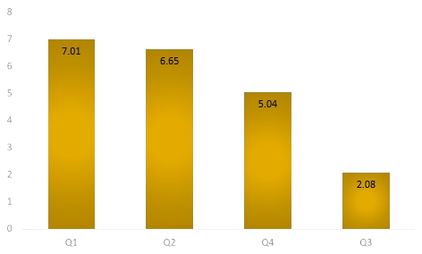
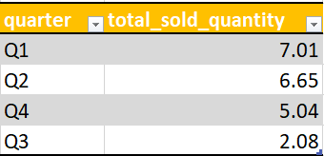
AtliQ Harfware
In which quarter of 2020, got the maximum total_sold_quantity? The final output contains these fields sorted by the
total_sold_quantity,
Quarter
total_sold_quantity
REQUEST 8
OUTPUT
INSIGHT
1. In the third quarter of fiscal year 2020 (March, April, and May), marked by the peak of COVID-19 and widespread lockdowns impacting businesses, the sold quantity plummeted to 2.1 million.
2. Notably, there was a significant demand for computer accessories during this period as a large number of students commenced or persisted in completing their coursework online. This heightened demand likely contributed to the early rebound observed in the fourth quarter

Slide 16
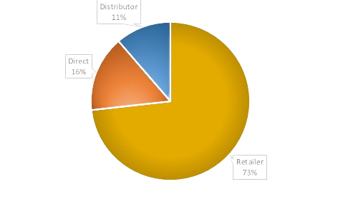
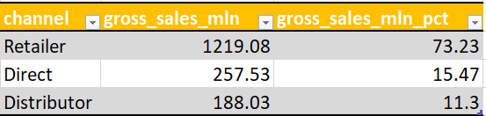
AtliQ Harfware
Which channel helped to bring more gross sales in the fiscal year 2021 and the percentage of contribution? The final output contains these fields,
channel
gross_sales_mln
percentage
REQUEST 9
OUTPUT
INSIGHT
A substantial 73% of Atliq's total sales were conducted through retailers, constituting the majority of its overall sales. In contrast, sales through direct and distributor channels made up a comparatively modest portion of the total revenue.

Slide 17
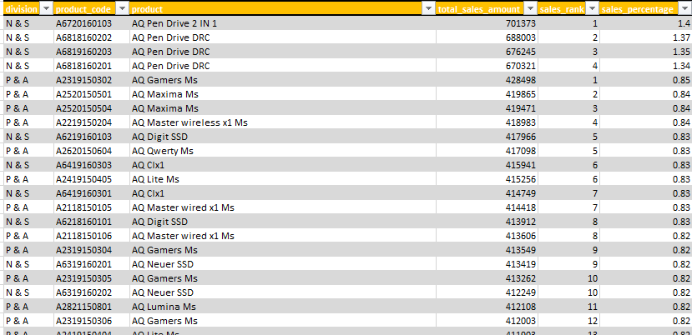
AtliQ Harfware
Get the Top 3 products in each division that have a high total_sold_quantity in the fiscal_year 2021? The final output contains these fields,
division
product_code
REQUEST 10
OUTPUT

Slide 18
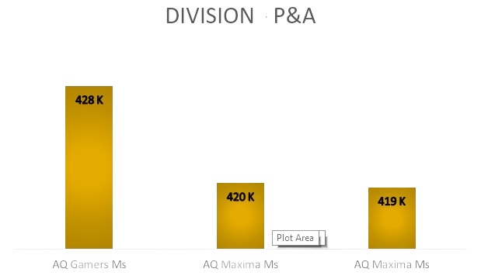
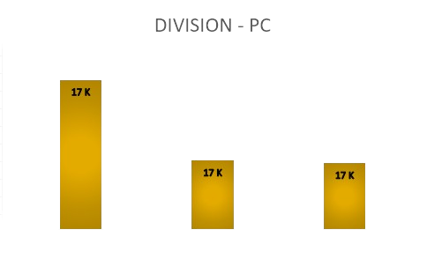
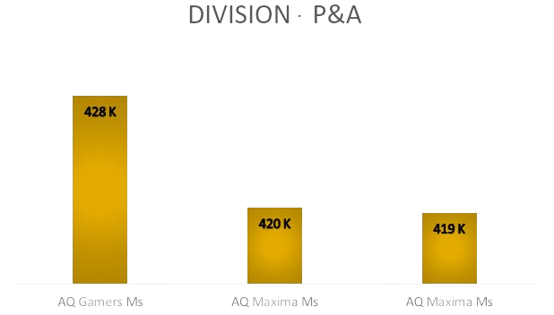
AtliQ Harfware
INSIGHT
The three best-selling products in the N & S division were pen drives.
The three best-selling products in the P & A division were pen mouse.
The three best-selling products in the PC division were laptops.

Slide 19
AtliQ Harfware
RECOMMENDATIONS FOR ENHANCING ATLIQ'S SALES PERFORMANCE
1. Provide excellent customer service and build lasting relationships.
2. Implement an effective marketing strategy across various channels.
3. Develop a strong brand identity and communicate your unique value.
4. Invest in sales team training for improved performance.
5. Offer competitive pricing and attractive promotions.
6. Enhance your product offerings to meet market demands.
7. Gather customer feedback to continuously improve

Slide 20

AtliQ Harfware
THANK YOU
HOW TO REACH ME ?
Mail - tarunyadav0427@gmail.com
- Tarun Yadav

